Slide 1

Sesstion 3

Slide 2
Classification Pipeline: Model Selection, Evaluation & Improvement
From CSV Data to Accurate Predictions

Slide 3
Classification Pipeline Overview
Load and preprocess CSV data
Select suitable classification models
Train models with appropriate techniques
Evaluate model performance
Improve results through tuning & ensemble

Slide 4
Model Selection for Classification
Support Vector Machine (SVM) – High-dimensional performance
Decision Trees – Easy to interpret, prone to overfitting
K-Nearest Neighbors (KNN) – Simple, instance-based
Logistic Regression – Probabilistic, interpretable
Random Forest (RF) – Ensemble of trees, good default

Slide 5
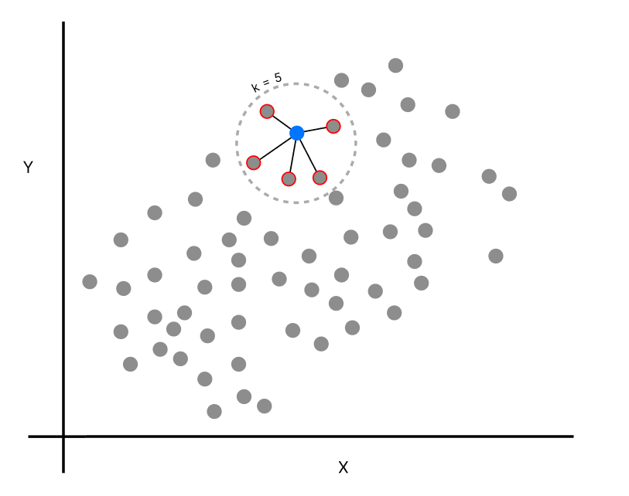
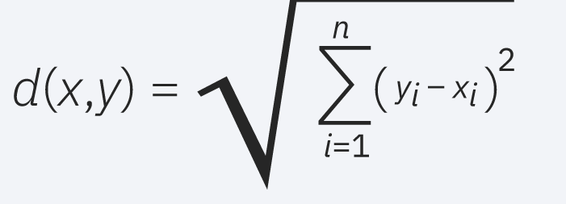
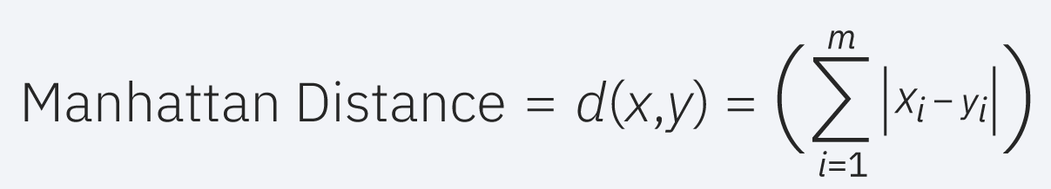
K-Nearest Neighbors (KNN)
How it works: Classifies a data point based on the majority class among its k nearest neighbors (using distance metrics like Euclidean).
Pros:
- Very simple, no training phase
- Good for well-separated classes
- Non-parametric
Cons:
- Slow at prediction time
- Sensitive to feature scale and irrelevant features
- Struggles with high dimensions

Slide 6
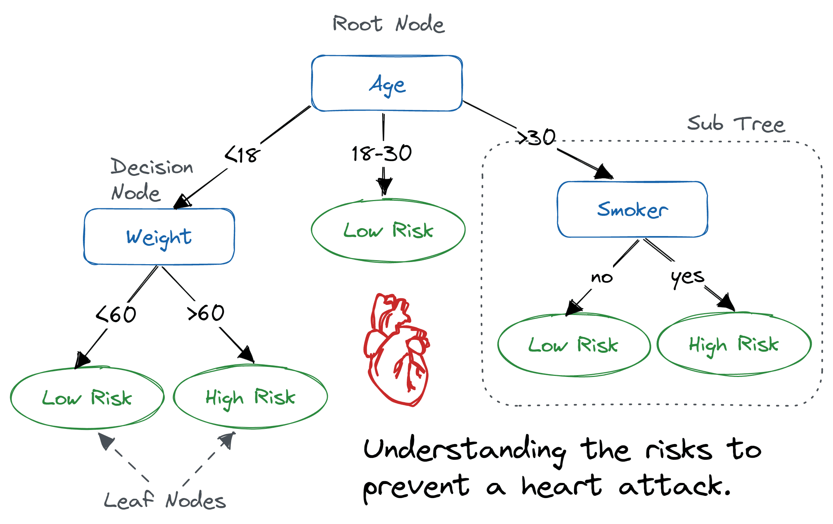
Decision Trees
How it works: Recursively splits data by feature thresholds. Splits are based on Gini impurity or entropy.
Pros:
- Easy to visualize and understand
- No need for feature scaling
- Handles numeric and categorical data
Cons:
- Easily overfits
- Small data changes can change tree structure

Slide 7
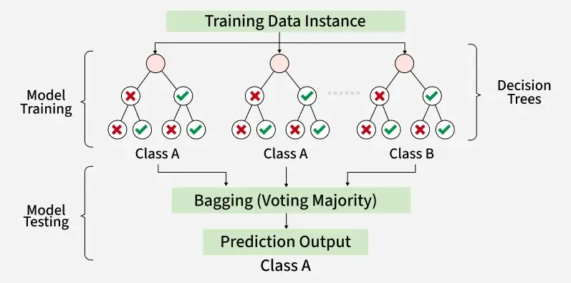
Random Forest (RF)
How it works: Trains multiple decision trees on different data and feature subsets, and predicts by majority vote.
Pros:
- Reduces overfitting of individual trees
- Handles missing and noisy data
- Performs well without much tuning
Cons:
- Slower training and inference
- Less interpretable than single decision tree

Slide 8
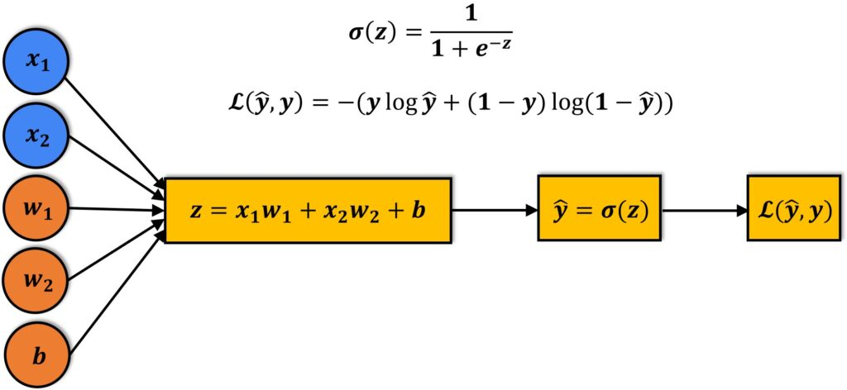
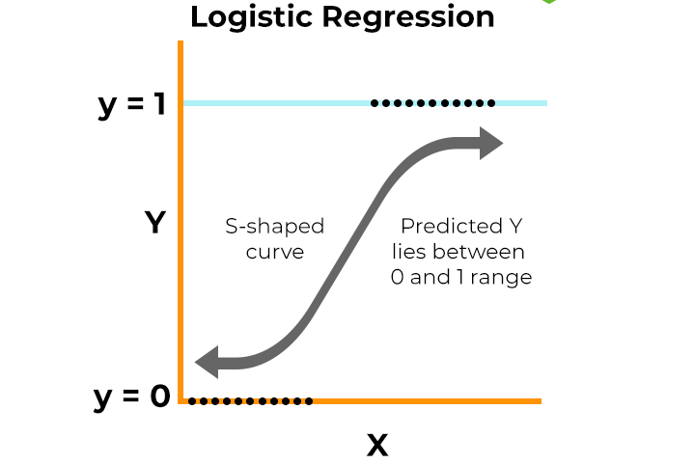
Logistic Regression
How it works: Computes weighted sum of inputs and passes it through a sigmoid function to produce probabilities.
Pros:
- Easy to interpret coefficients
- Outputs probabilities
- Efficient on large datasets
Cons:
- Assumes linearity between input and log-odds
- Limited to linear decision boundaries

Slide 9
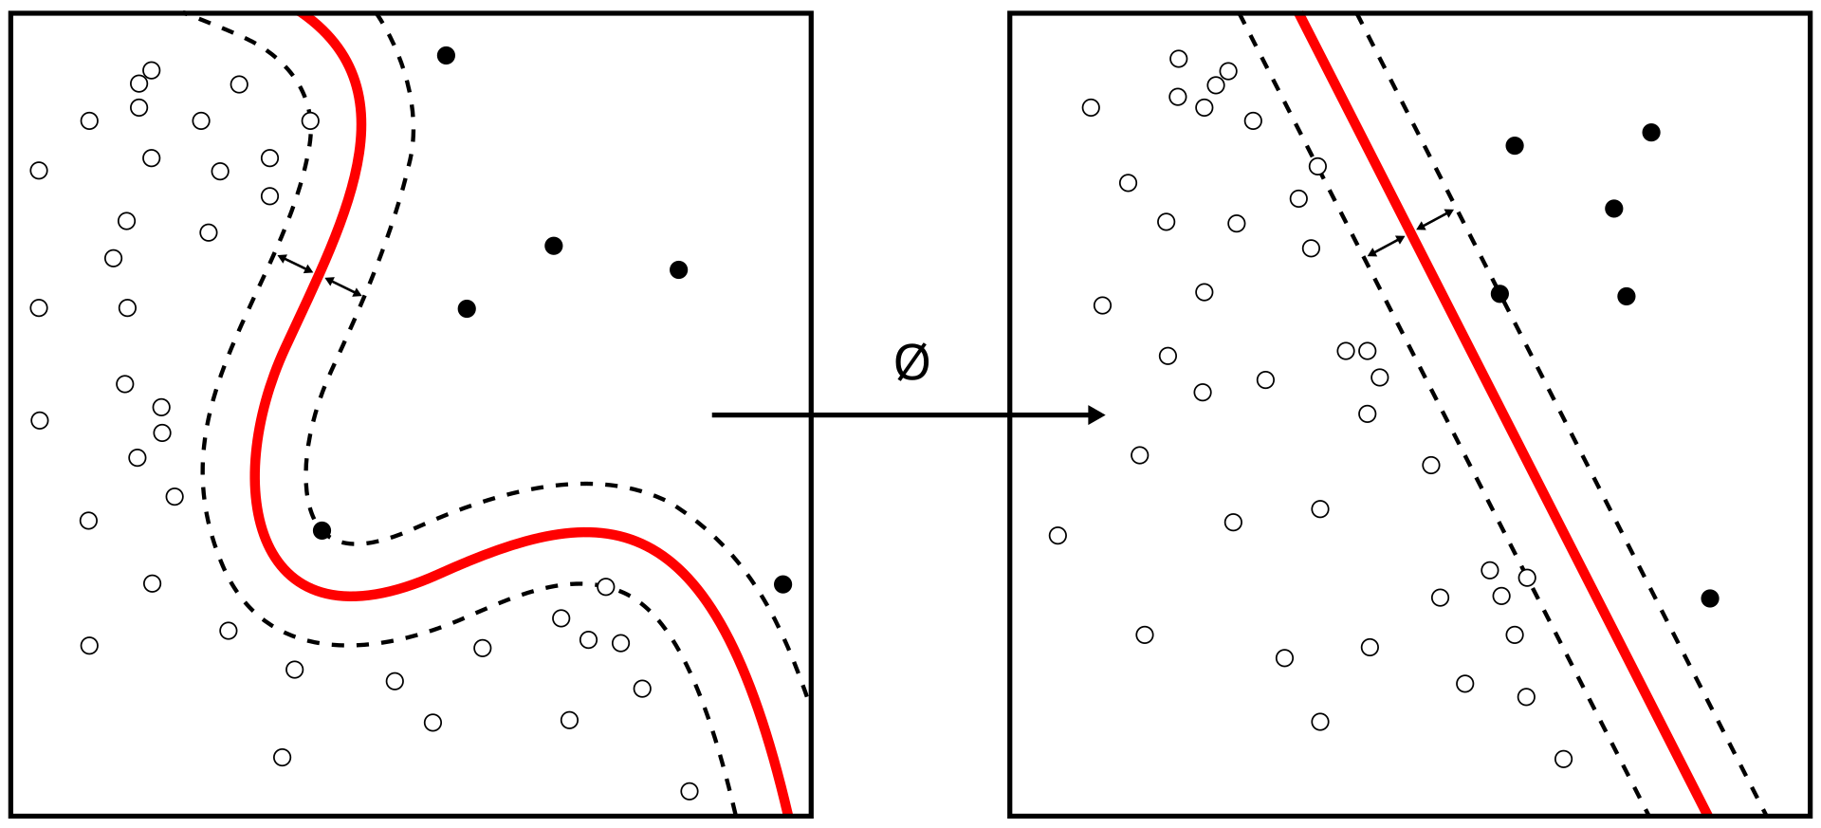
Support Vector Machine (SVM)
How it works: SVM finds the optimal hyperplane that separates data points of different classes with the maximum margin. Kernel tricks (e.g., RBF) allow non-linear separation.
Pros:
- Works well in high-dimensional data
- Effective in separable cases
- Robust with proper regularization
Cons:
- Slow for large datasets
- Sensitive to noise and overlapping classes
- Less interpretable

Slide 10
Training Classifiers
Use .fit(X_train, y_train) to train
Some models require no epochs (e.g., RF, SVM)
Neural models (not covered here) use epochs and backpropagation
Importance of train_test_split() for validation

Slide 11
Improving Model Settings
GridSearchCV: Exhaustive parameter search
RandomSearchCV: Random combinations for speed
Use cross-validation (cv=5) to avoid overfitting on one split
Example: GridSearch on KNN (see code in notes)

Slide 12
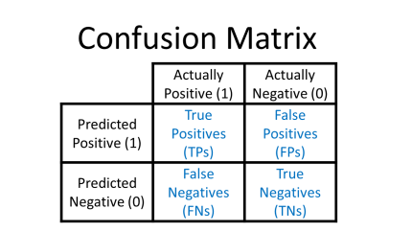
Model Evaluation Metrics
Confusion Matrix: TP, FP, TN, FN
Precision: TP / (TP + FP) => if cost of FP is important
Recall: TP / (TP + FN) => if cost of FN is important
F1-Score: Harmonic mean of precision & recall

Slide 13
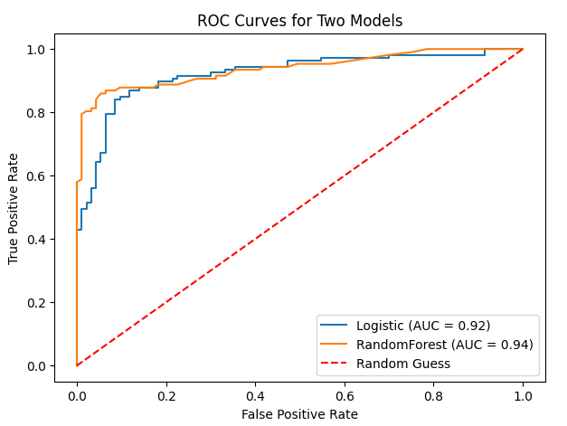
Additional Evaluation Tools
ROC Curve: Tradeoff between TPR and FPR
AUC Score: Area under the ROC curve
For imbalanced classes, use Precision-Recall Curve

Slide 14
Regression Metrics (Reference Only)
MAE (Mean Absolute Error)
RMSE (Root Mean Squared Error)
R² Score: Proportion of variance explained

Slide 15
Model Improvement Strategies
Error Analysis: Examine where/why model fails
Handle Class Imbalance: SMOTE, class weights
Feature Engineering: Improve or remove weak features

Slide 16
Boost Accuracy with Ensembles
Bagging: Random Forest, multiple learners on subsets
Boosting: Sequential improvement (e.g., XGBoost)
Often improves generalization and reduces variance

Slide 17
Understanding Model Fit
Underfitting: High bias, poor training performance
Overfitting: High variance, poor test performance
Use learning curves, validation scores to detect
Regularization & simpler models can help

Slide 18
Understanding Bias and Variance
Bias and variance are two sources of error in machine learning models:
• Bias: Error from incorrect assumptions in the learning algorithm.
- High bias ➝ Underfitting (model too simple)
• Variance: Error from sensitivity to small fluctuations in the training set.
- High variance ➝ Overfitting (model too complex)

Slide 19
The Bias-Variance Tradeoff
The goal is to balance bias and variance to minimize total error:
• Low Bias + Low Variance ➝ Ideal (rare in practice)
• High Bias + Low Variance ➝ Underfitting
• Low Bias + High Variance ➝ Overfitting
Use techniques like cross-validation, regularization, and ensemble methods to manage this tradeoff.

Slide 20
The Bias-Variance Tradeoff
Term | Meaning | Detected by
Bias | Model too simple, underfitting | High error on training and test
Variance | Model too complex, overfitting | Low error on train, high on test

Slide 21
Questions & Discussion
Ready to explore your dataset!
Let's discuss model behavior on real examples.

